Slide 1

- ETL Project -
Restaurant Data with Consumer Ratings
By Hari, Chadwick and Sam

Slide 2
Extraction
The public platform Kaggle lead us to the “Restaurant Data with Consumer Ratings” website which had 5 different datasets having following information:
The following is the source our datasets used:
https://www.kaggle.com/uciml/restaurant-data-with-consumer-ratings/metadata
User profile and their preferences | userprofile.csv
Restaurant Related Information | geoplaces2.csv
Restaurant Ratings | rating_final.csv
Restaurant Cuisine Speciality | chefmozcuisine.csv
Restaurant Parking Availability | chefmozparking.csv

Slide 3
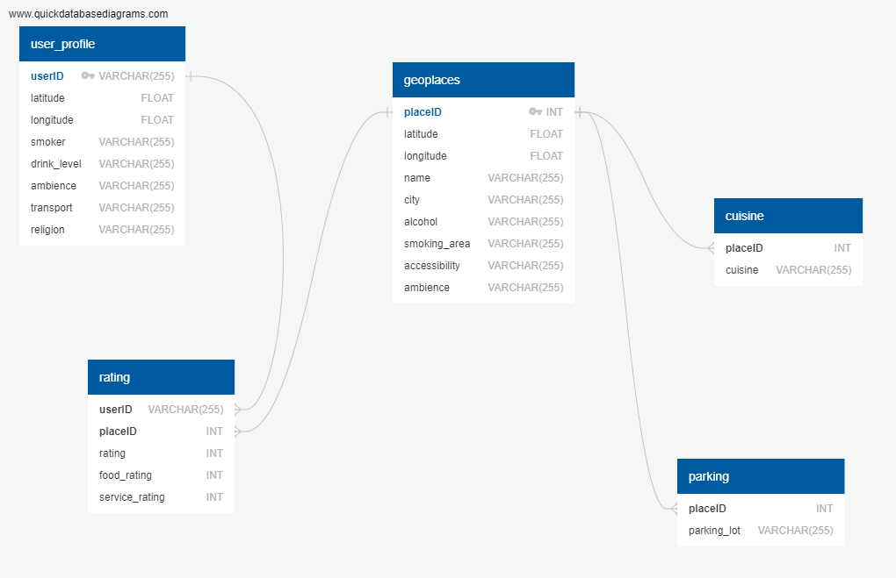
ER Diagram
The real datasets had more number of fields however we choose to pick fields of interest:

Slide 4
Observations
The following table illustrates the observations we would like to address:
Top 5 best restaurants for families
Top 5 worst restaurants based on service rating
Does Parking lot affect the restaurant rating
Which City has most elevated no of restaurants with higher rating
Does alcohol/no alcohol affect the restaurant rating
No of restaurants based on Cuisine

Slide 5

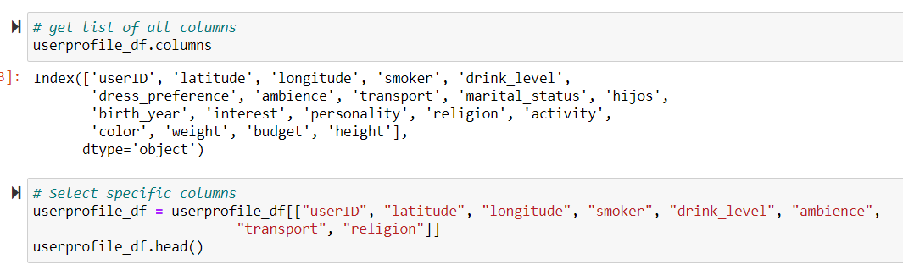
Transformation
In order to transform the restaurant data and use it in our study we performed the following:
Reviewed the Datasets and transformed into data frames
Selected the specific columns from Datasets with respect to observations

Slide 6

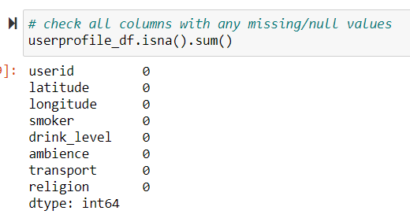

Transformation
Used Pandas functions to rename the columns to avoid data load failure with Postgres
Used Pandas functions to catch Missing/Null values
Some of the Datasets had "?" as opposed to Missing/Null values, we have replaced them with 'Not Recorded' to avoid Referential Integrity errors for Postgres.

Slide 7
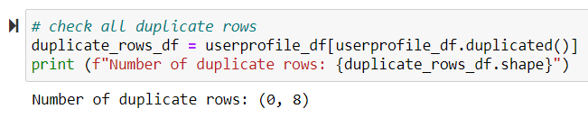
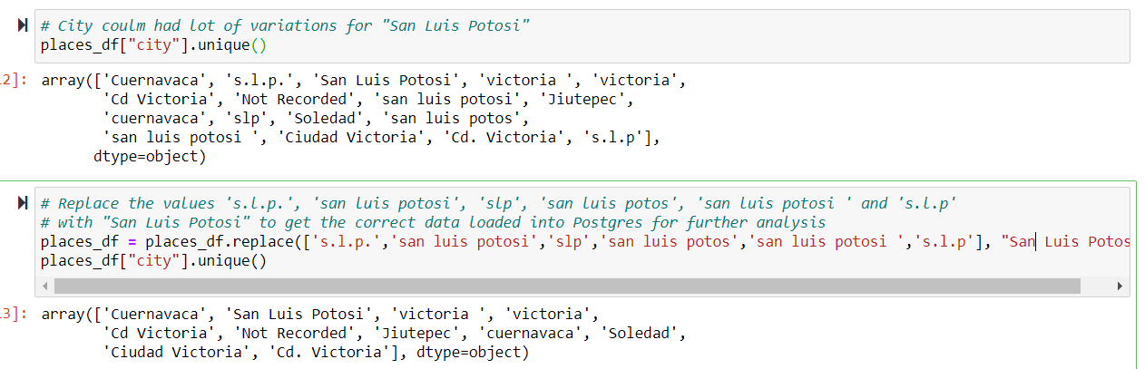
Transformation
Used Pandas functions to catch the duplicate values and drop them to get the clean Dataset
City column from Geoplaces table had multiple variations for City names, we corrected those to get the clean dataset

Slide 8
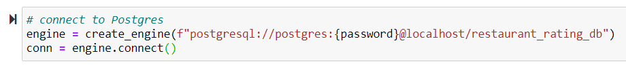
Transformation
Used Sqlalchemy to connect to Postgres Database
Used Pandas functions to load all 5 CSV Datasets into Postgres Database.

Slide 9
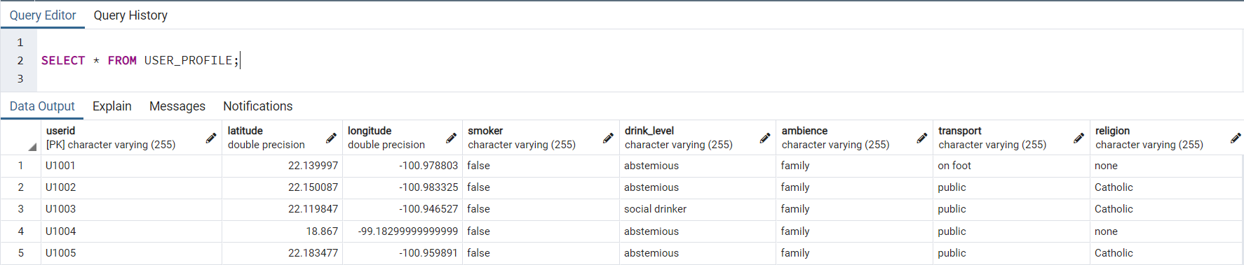
Load
After we pulled in the CSV files and loaded them into the data frames, we did an initial connection to the Postgres database using PGAdmin to store our transformed data sets.
We used the quick database website to create the initial table schema that got loaded into the Postgres database that generated the first set of tables by maintaining the Referential integrity.
USER_PROFILE

Slide 10
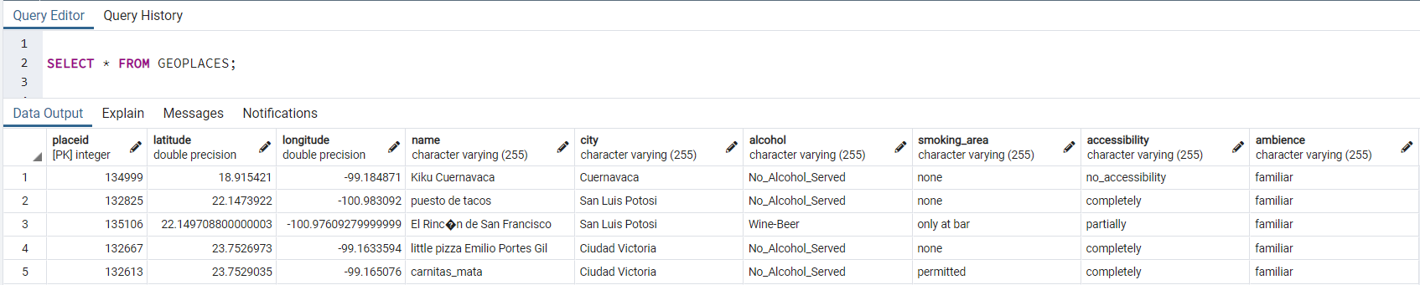
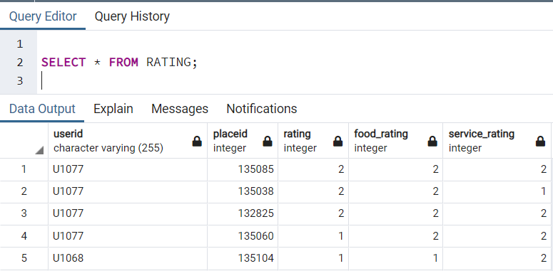
Load
GEOPLACES
RATING

Slide 11
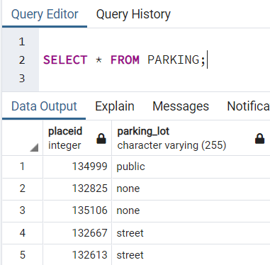
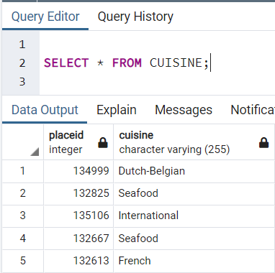
Load
PARKING
CUISINE

Slide 12
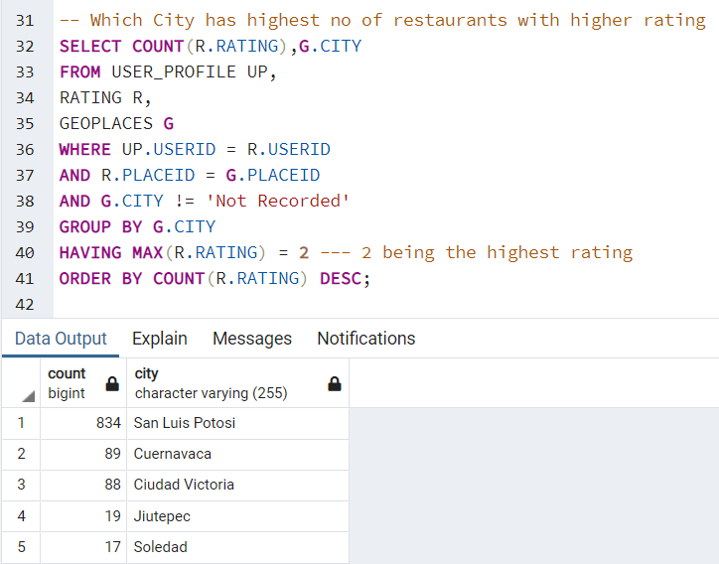
Summary
The time constraint and limited set of information were a portion of the primary imperatives which influenced our investigation of this ETL project. But, we were still managed to come up with below observations which should provide sufficient thought about the dataset what we are dealing herewith -
Which City has most elevated no of restaurants with higher rating?
The city “San Luis Potosi” has one of the best rated restaurants in Mexico. The highest number of better rated restaurants makes it ideal destination for tourism.

Slide 13
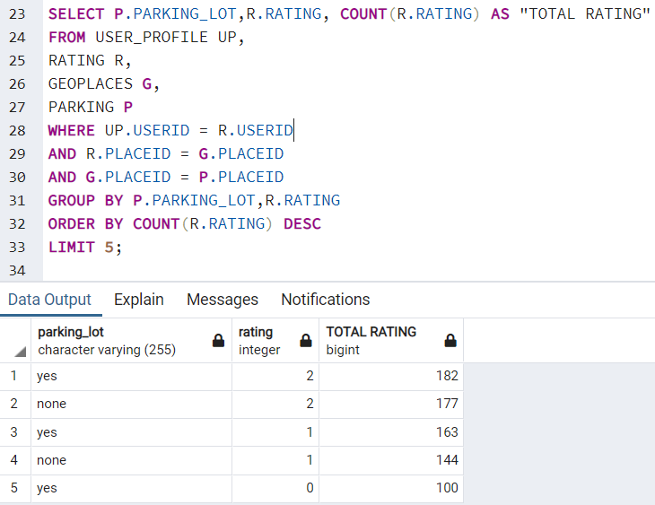
Summary
Does Parking lot affect the restaurant rating?
When it comes to overall rating of restaurants, users doesn’t seems to care much about availability of parking. The second record shows even though parking is unavailable still users has given higher rating.

